Slide 1
COMPETENCY BASED HRM
Unit 3

Slide 2
COMPETENCY AND PERFORMANCE
Competencies represent the language of performance. They can articulate both the expected outcomes from an individual’s efforts and the manner in which these activities are carried out.
Because everyone in the organization can learn to speak this language, competencies provide a common, universally understood means of describing expected performance in many different contexts.

Slide 3
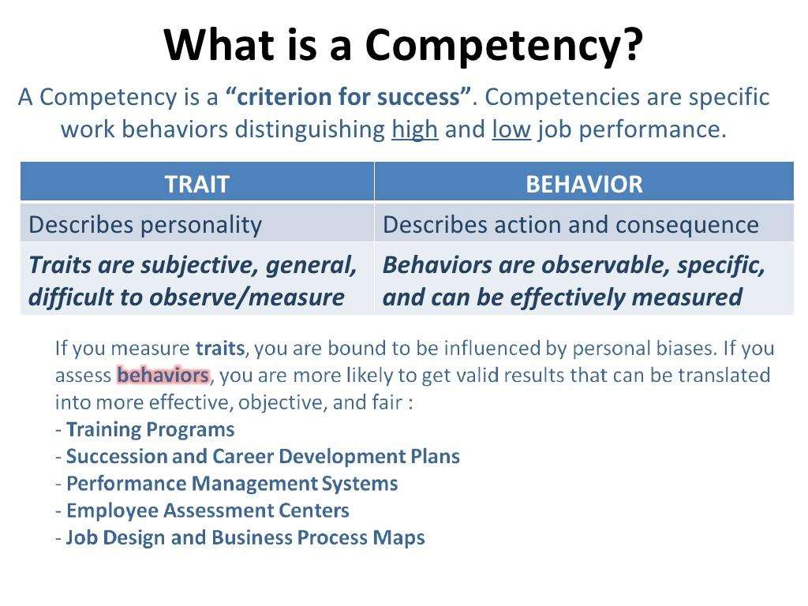

Slide 4
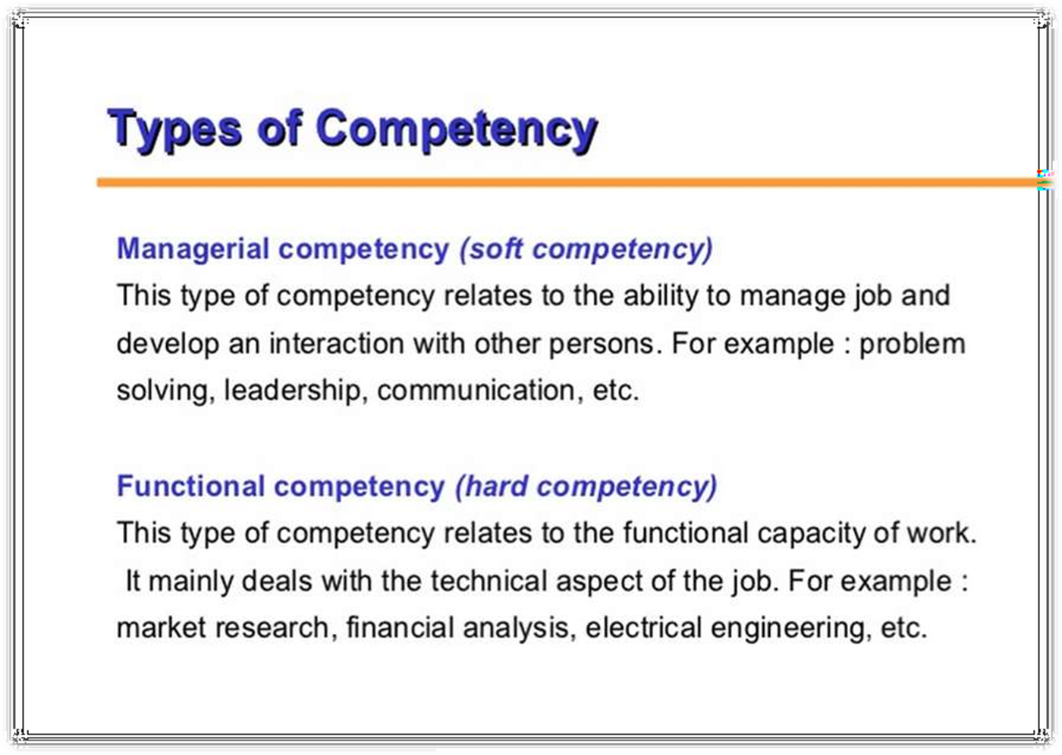

Slide 5
REASONS FOR USING COMPETENCIES
The main reasons given by companies for the use of competencies are:
The application of competencies to appraisal, training and other personnel processes will help to increase the performance of employees.
Competencies provide a means of articulating corporate values and objectives so that their requirements can be embodied in HR practices and be readily understood by individuals and teams within the organization
Competencies are used as a means of achieving cultural change and raising skill levels.

Slide 6
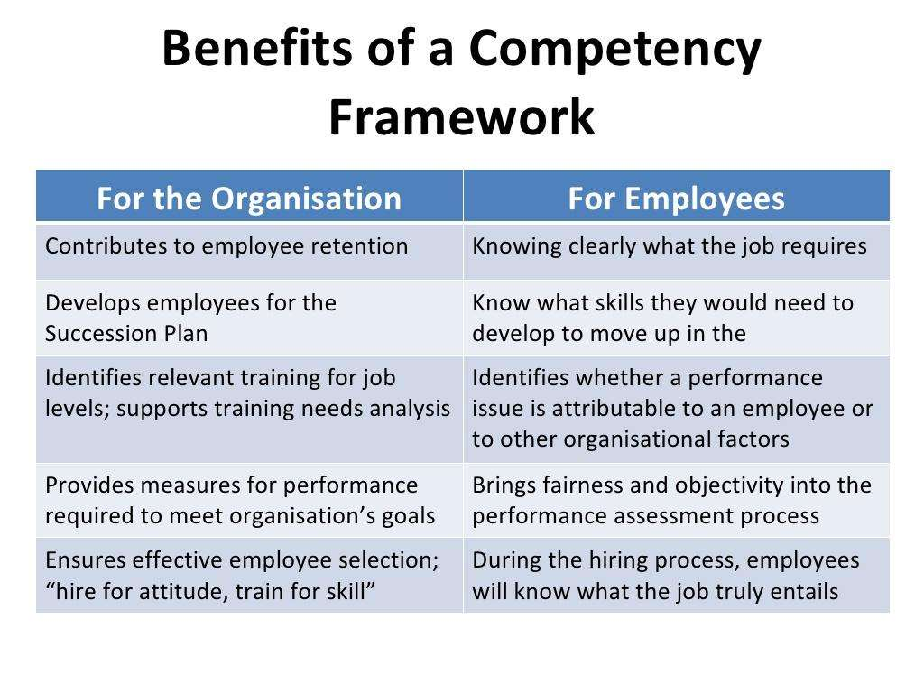

Slide 7
THE FIVE MOST POPULAR USES OF COMPETENCY
Performance management Personal development Selection Recruitment Training needs analysis | 81%
 | 75%
 | 74%
 | 61%
 | 61%
Competency
0% 50%
Percentage of surveyed firms using competency
100%

Slide 8
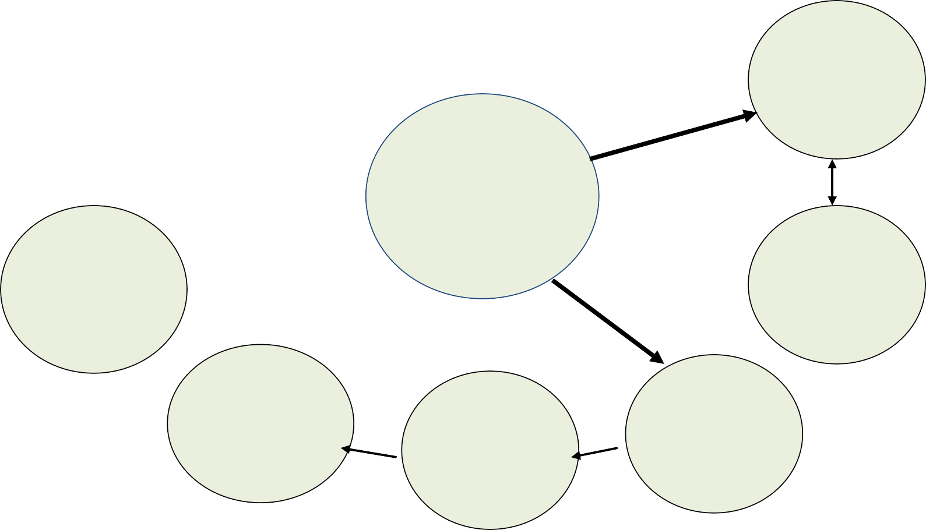

APPLICATIONS OF COMPETENCY
Organization design and development
Job and role design
Contribution- related pay
Recruitment and selection
Competency framework
Assessment/ development centres
Career-family structures
Personal development
Performance management
Learning needs analysis

Slide 9
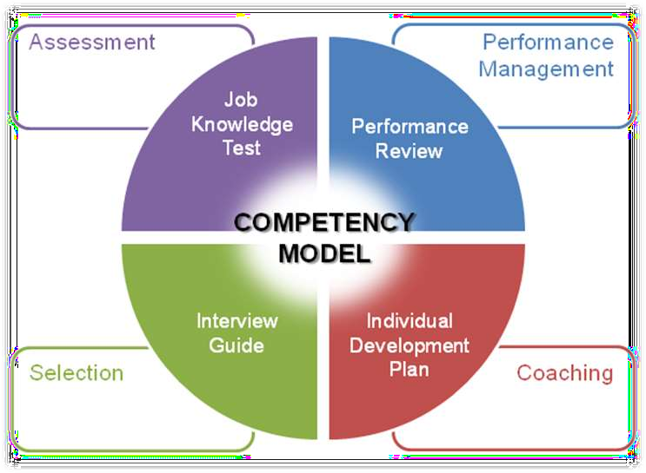
Competency Model
10

Slide 10
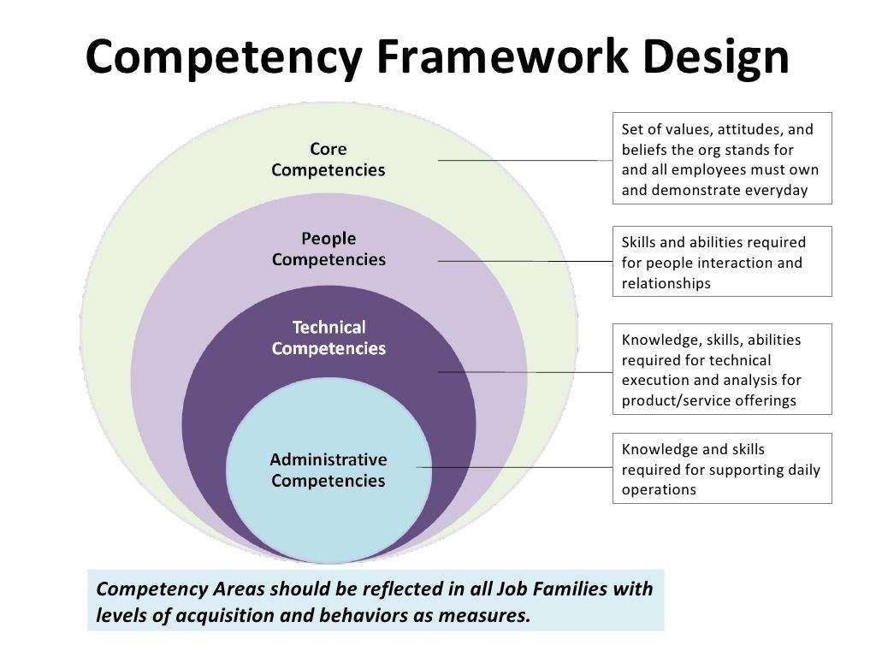

Slide 11
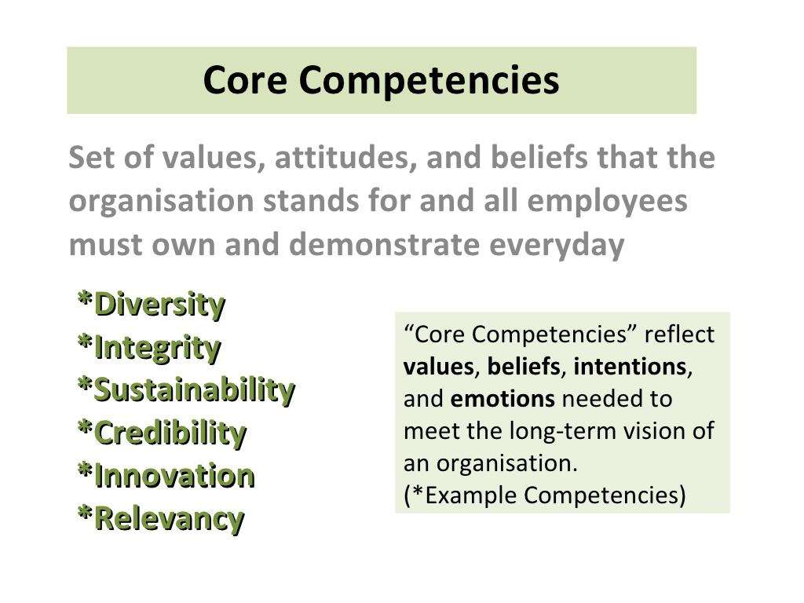

Slide 12
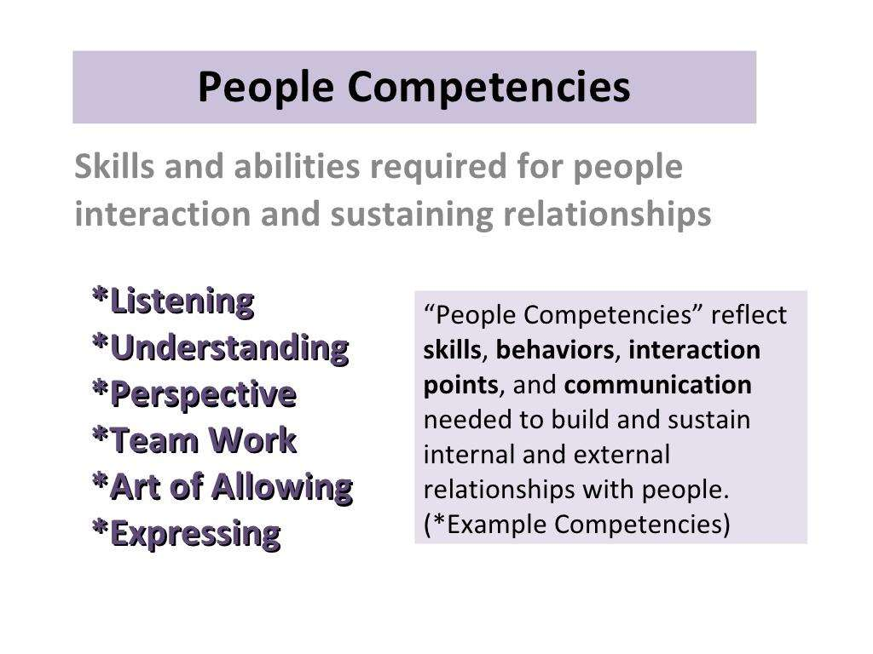

Slide 13
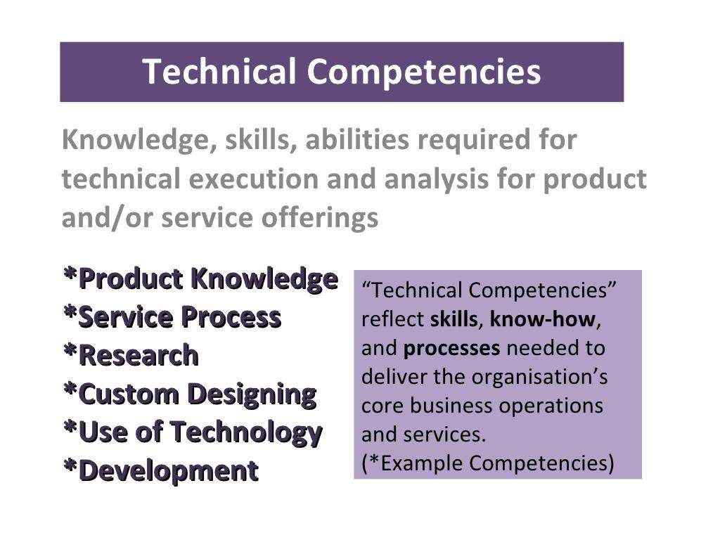

Slide 14
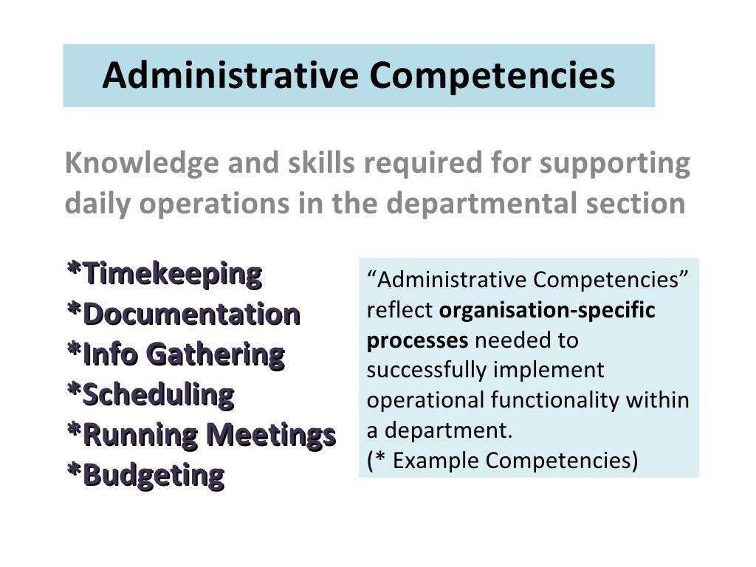

Slide 15
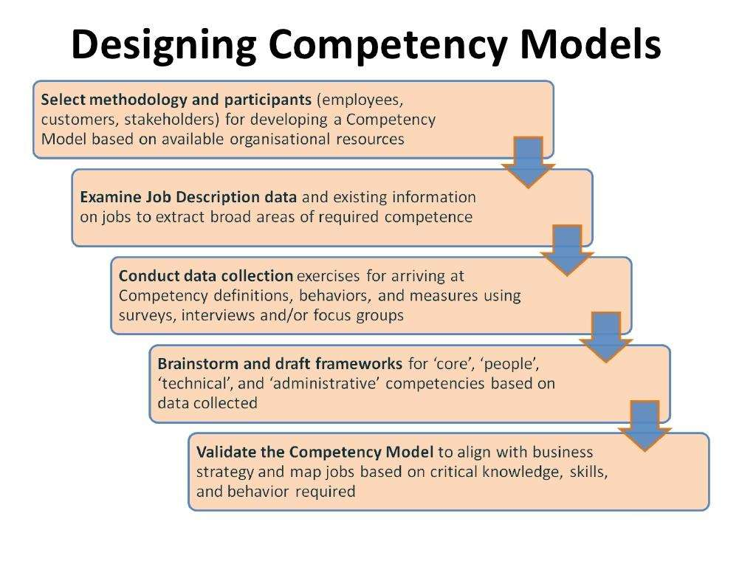

Slide 16
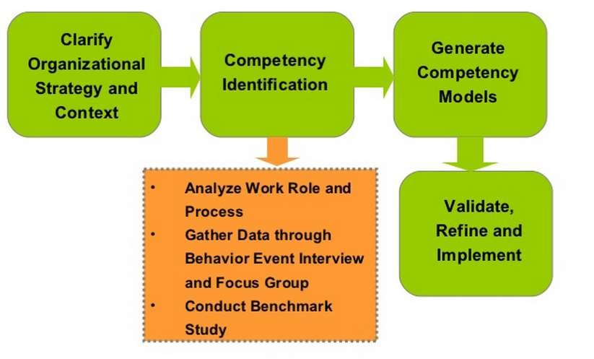
Competency Identification Process
17

Slide 17
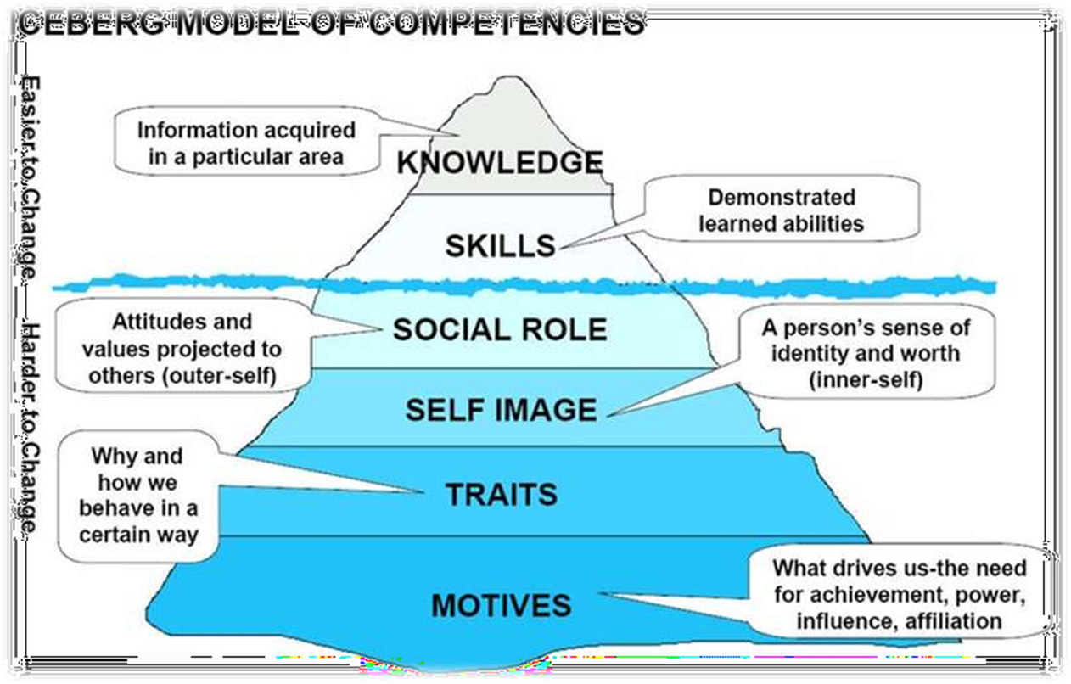

Slide 18






Competencies Create Alignment
CORE & FUNC. COMPETENCIES
Job Descriptions
Career Development
Structured Behavioral Interviews
Selection & Succession Systems
Leadership Development
Training
Performance Management

Slide 19
9-Box Talent Grid
Continuing investment (May be recently promoted) | 1/3 | High investment, help impro₂v/e₃ performance |  | High investment and/or _{3/3} promote/give more responsibility These “stars” are ready for an assignment at a higher organizational level – challenge them.
Monitor | 1/2 | Continuing investment | 2/2 | High investment, accelerate ski₃ll_{/2} development
Monitor Need to demand performance ^{1/1} improvements May be in wrong job or at wrong level. Consider reassignment. |  | Continuing investment | 2/1 | Minimal investment but continue to reward, retain 3/1
Accelerated Growth Potential
Solid Growth Potential
Stable Growth Potential
Growth Potential
Needs Improvement
Meets Expectations
Exceeds Expectations
Past Performance

Slide 20
CBHRM ON RECRUITMENT & SELECTION
Position Description
Discussions with Dept Heads, Managers, Supervisors
Incumbents
Focus groups
Make a list and classify according to category

Slide 21
An Example Competency of Programmer Analyst
Designs applications, significant subsystems, and/or complete individual programs
Identifies alternative implementations or strategies and weigh the impact of each
Must be able to work as a member of the team
Capable of learning new ideas quickly
Able to develop software of the highest quality in a high pressure environment with other team members
Able to meet deadlines
Experienced with complex modules/systems

Slide 22
COMPETENCY BASED INTERVIEW

Slide 23
A Conventional Interview
Questions are not designed systematically and not properly structured
Seldom equipped with formal guidelines regarding system of rating/scoring the interview
No standard format, therefore process of interviewing can go in any direction
Low reliability and validity
Susceptible to bias & subjectivity

Slide 24
Competency Based Interview
A behavioural-based interviewing process designed to provide employers with specific data that allows them to predict future job related behaviour
Questions will evolve around personal experiences of the applicant and practical work related questions designed around specific and pre-determined competencies
Standard scoring system which refers to behaviour indicator

Slide 25
The CBT will be conducted as follows…
Introductions
Brief discussion of job
Competency based interviewing
Validation of technical/functional skills where necessary
Interviewee’s opportunity to ask questions
Close out

Slide 26
The STAR Approach
Situation in which you were involved
Task you needed to accomplish
Actions you took
Results you achieved

Slide 27
Competency Based Interviews
Precludes notions is based on the assumption that “Past Behavior is an indicator of Future Behavior” Decisions are made on facts
Structured, job specific, focused on concrete and intangible competencies

Slide 28
Example-HR Manager
Competency-ability to recruit & interview candidates
Q-Describe a time when you had a position open for an unreasonably long period of time
Q-Tell me about a time when you hired someone who later didn’t work out
Competency-ability to develop & maintain up to date job descriptions
Q-Describe your responsibilities
Q-Tell me about a time when you had difficulty developing a
job description

Slide 29
Common mistakes avoided…
Halo or Horns effect
Cloning
Inconsistency
First impressions
Primacy & Recency approach
Stereotyping
Prejudice

Slide 30
CBI enables you to…
Identify skills & characteristics needed to succeed in a specific work environment
Isolate competencies required for a given job
Earmark relevant experiences necessary to have acquired these competencies
Clarify what candidates have learned from their experiences
Determine whether candidates can explain what they have learned on a given job & work environment

Slide 31
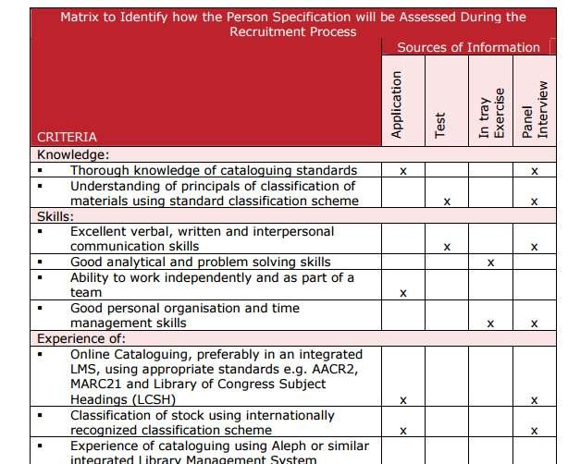
CBHRM Recruitment Form
34

Slide 32
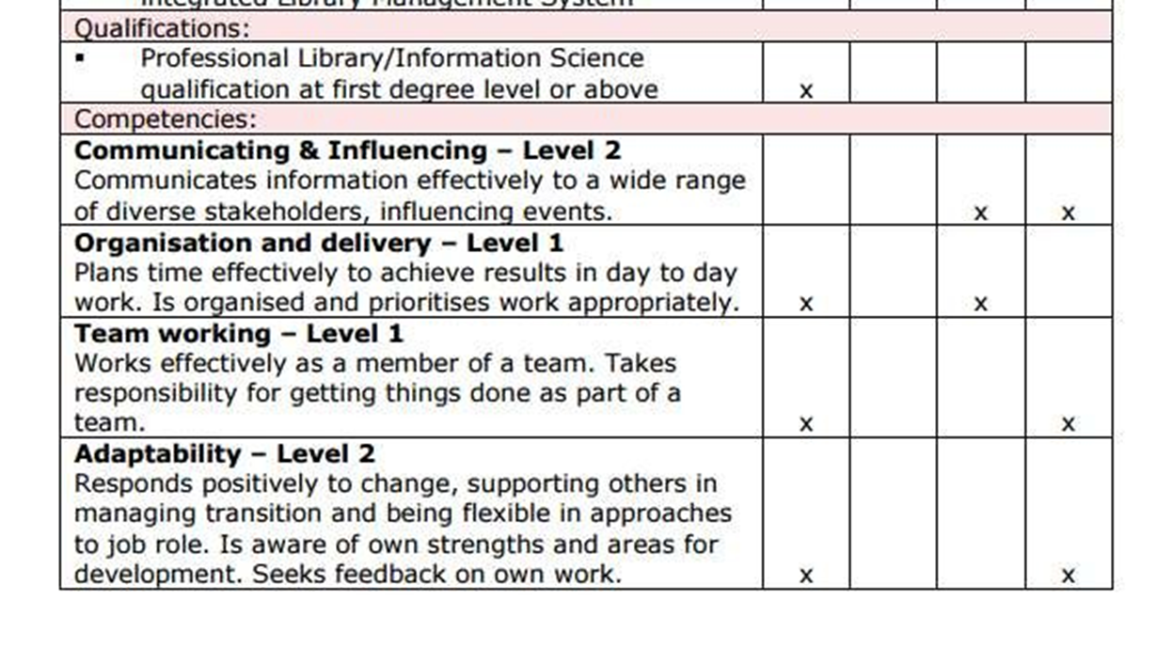

Slide 33
CBHRM on Performance Management
36

Slide 34
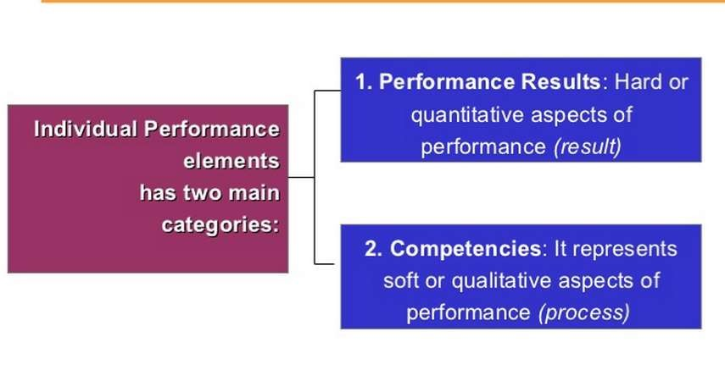
Individual Performance Element
37

Slide 35
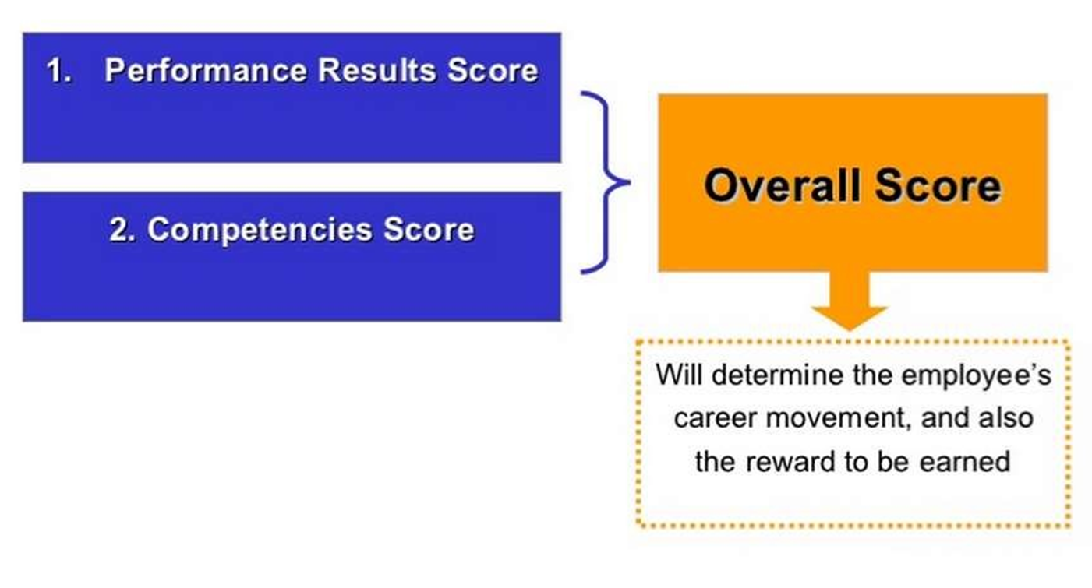

Slide 36
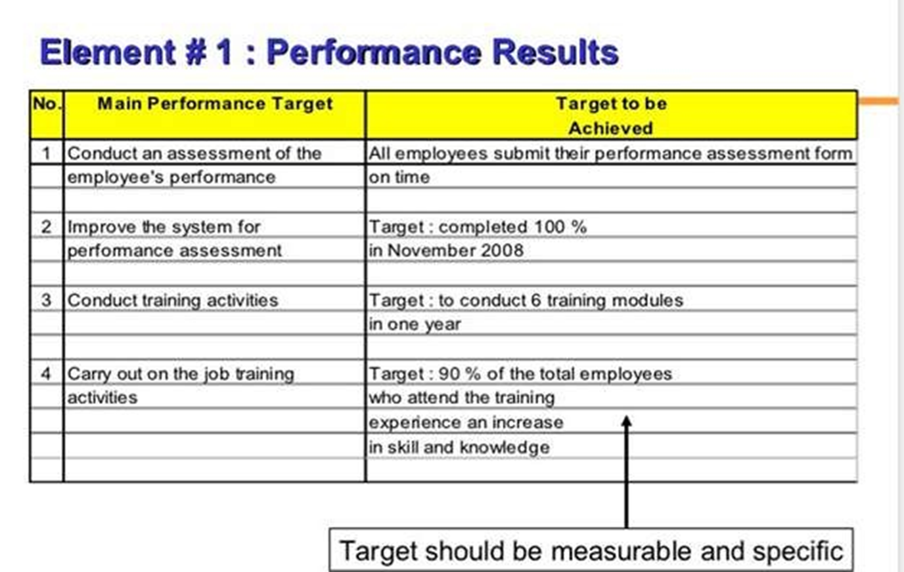

Slide 37
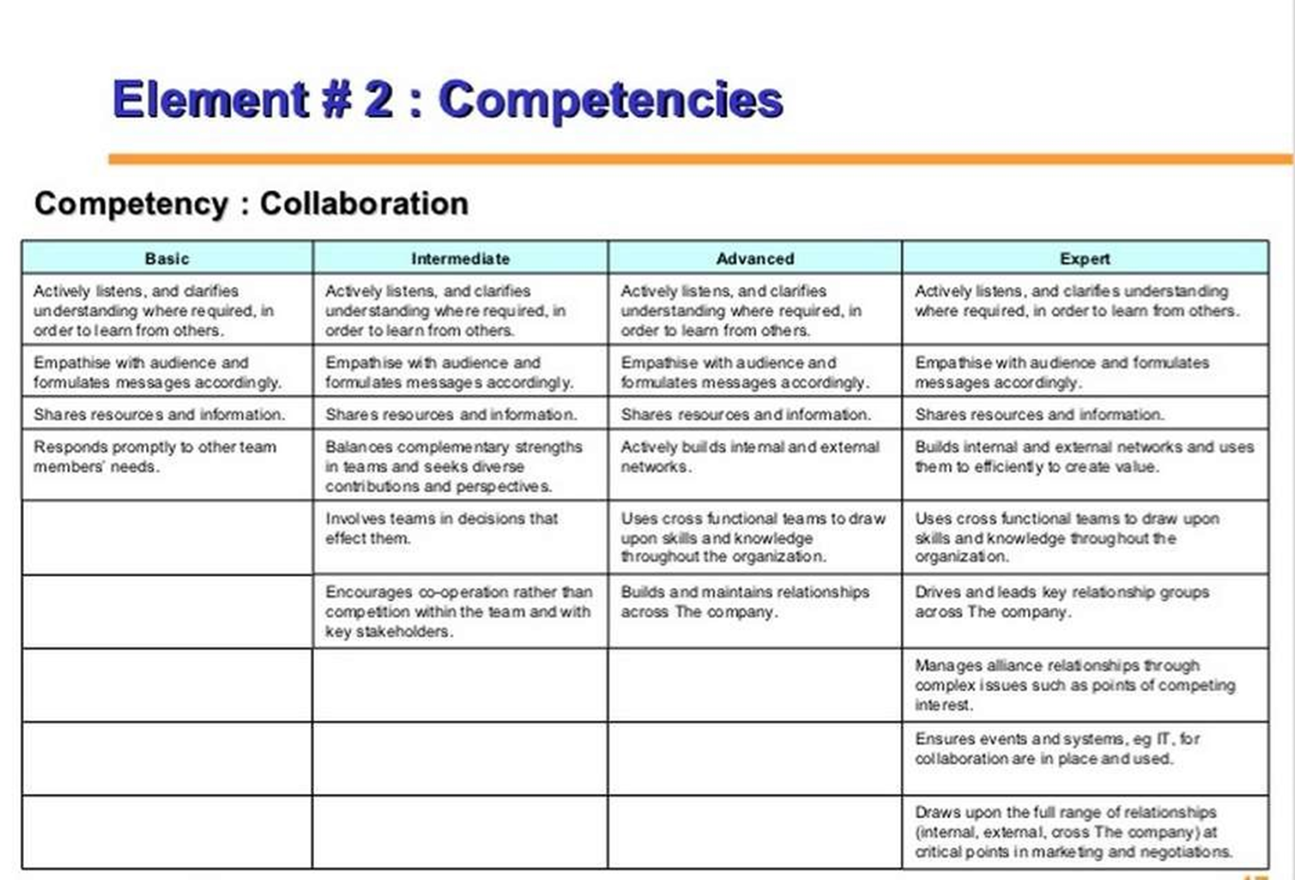

Slide 38






Competency-Based Strategic Alignment
Agency Performance Measure The HOW The WHAT
Performance Expectations / Appraisal / Development Needs |  | Skills / Competencies Needed |  | Input FTE/BUDGET |  | Activities & Outputs (Nuts & Bolts) | Strategies / Intermediate Outcomes | Agency Performance Measures | Quality of Life
*How do you plan on evaluating / developing performance? -Identifying skills gap -Communicating skills gap -Developing skills gap -Measuring success |  | What critical skills are needed to accomplish identified duties and activities? What are the skills of the persons working on the project? What is the gap between critical skills needed and skills of persons on project(s)? |  | What are the resources need to carry out stated duties, activities and outputs? Who are the employee's and/or AWEC’s assigned to complete the identified duties and activities? |  | What duties, activities, processes and/or procedures have been identified to carry out the strategy? | What divisions are directly working on this measure? What are their strategies and initial outcomes? | What are the goals and objectives of this measure? | The 10 Commitment to residents of the State. Where and how does the performance measure fit into Wyoming’s Quality of Life?
Department of Administration & Information - Human Resources Division

Slide 39
CBHRM on Training & Development
42

Slide 40
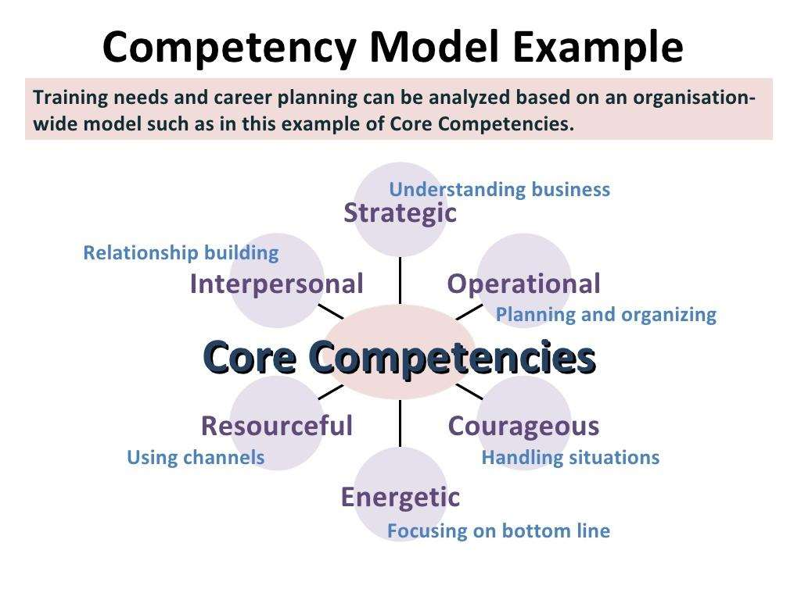

Slide 41
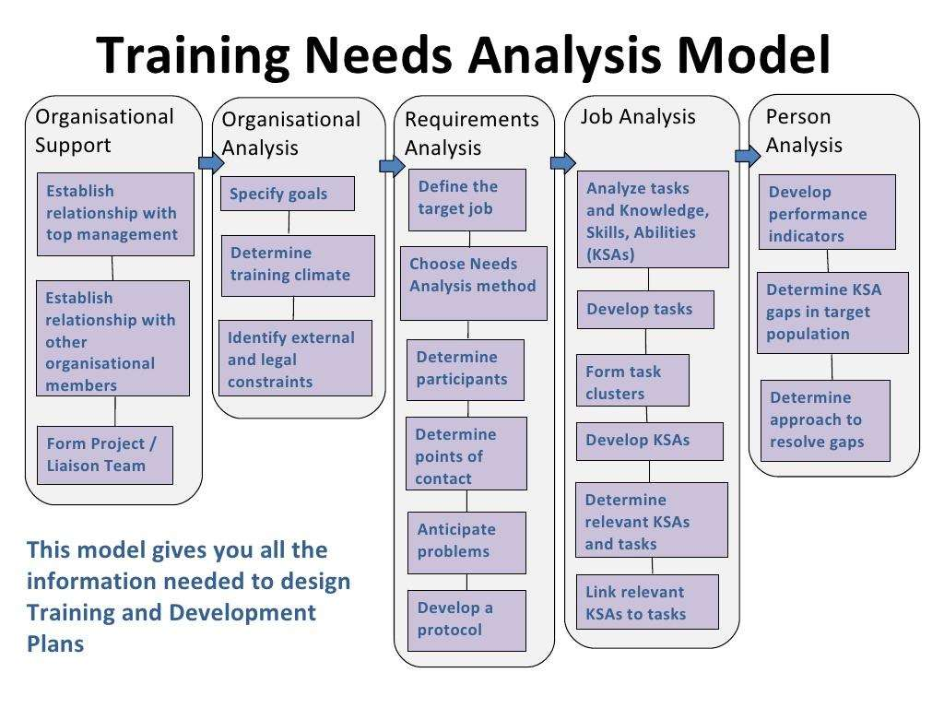

Slide 42
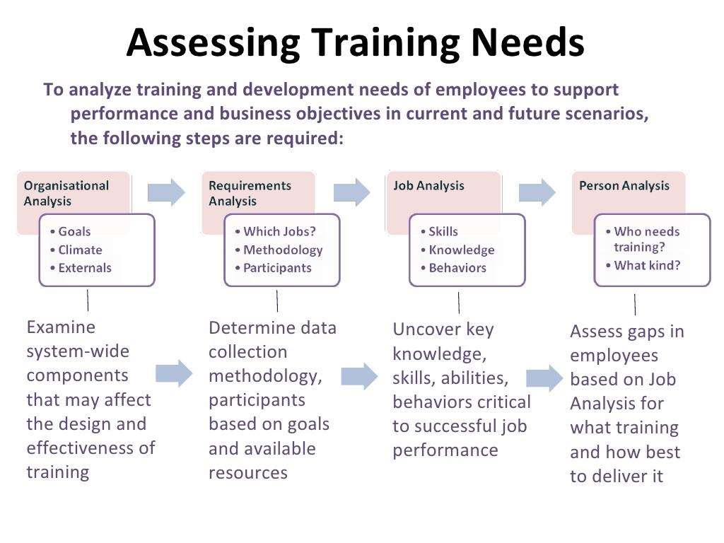

Slide 43
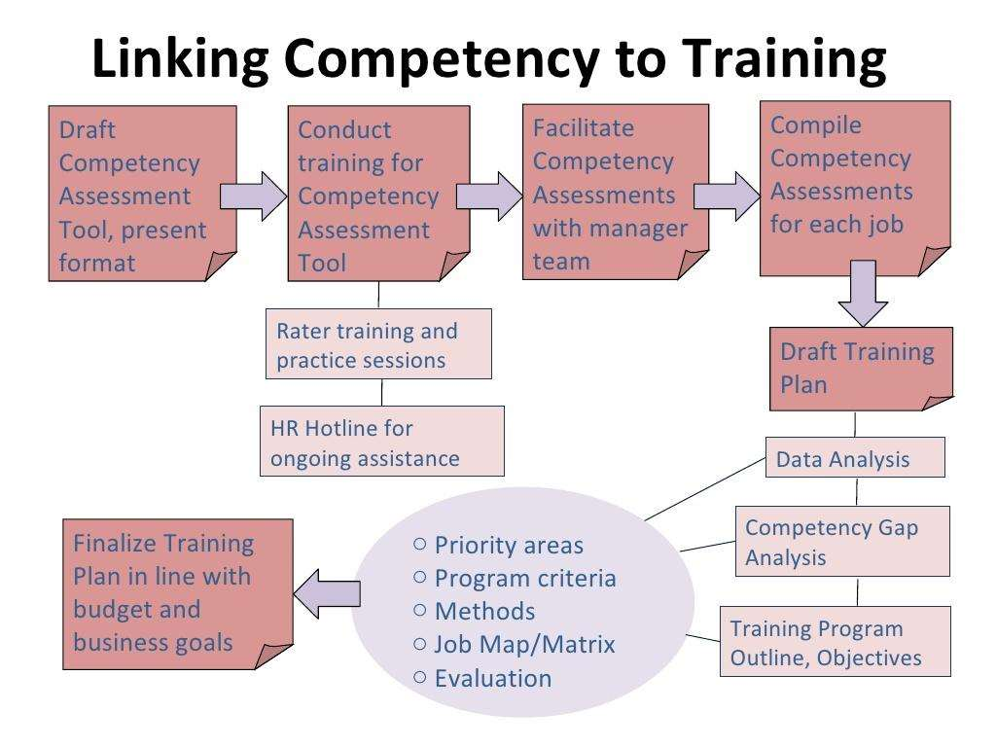

Slide 44
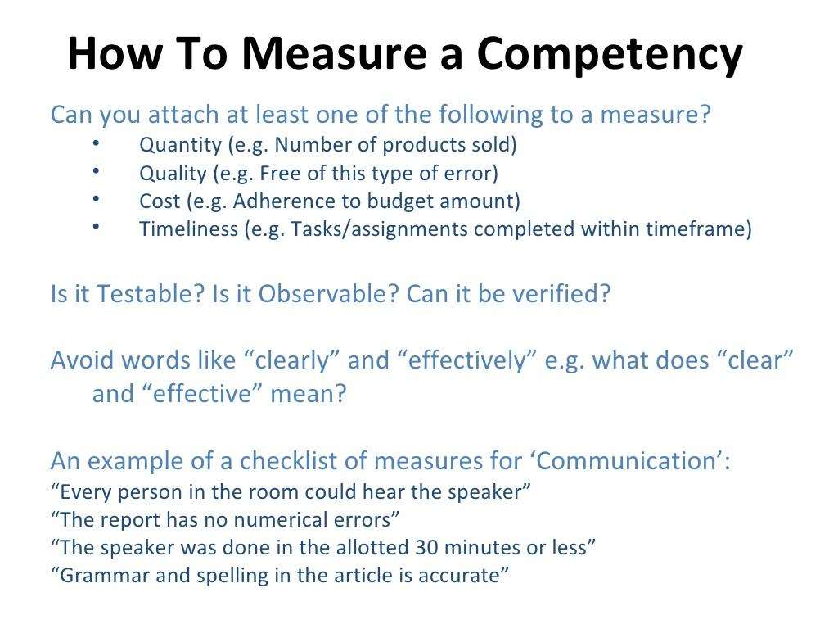

Slide 45
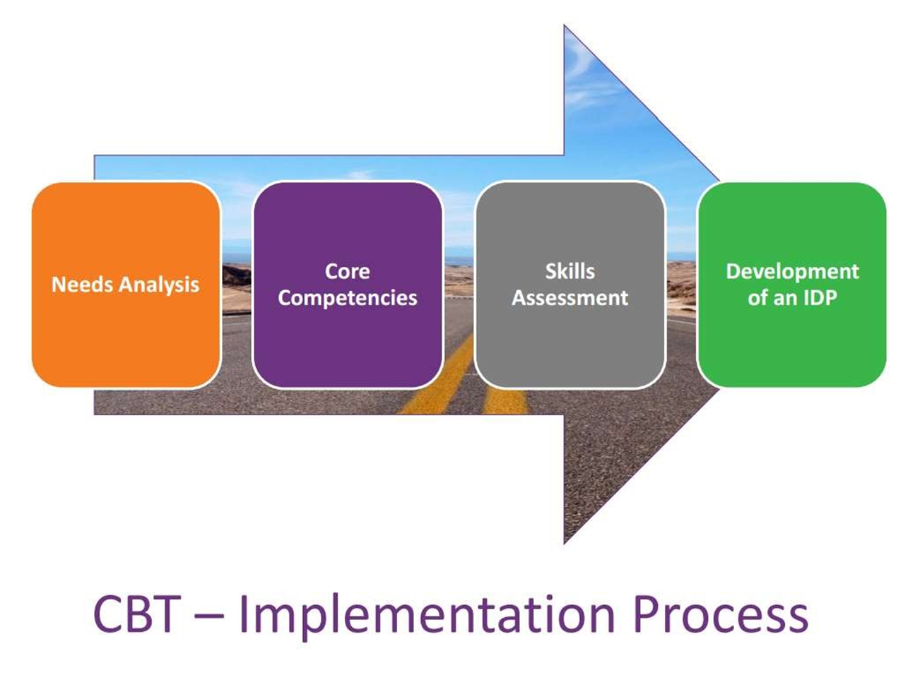

Slide 46
CBHRM Career Planning & Succession Planning
49

Slide 47
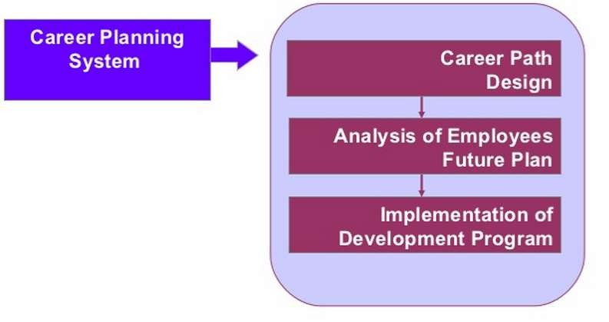
Career Planning Flow
50

Slide 48
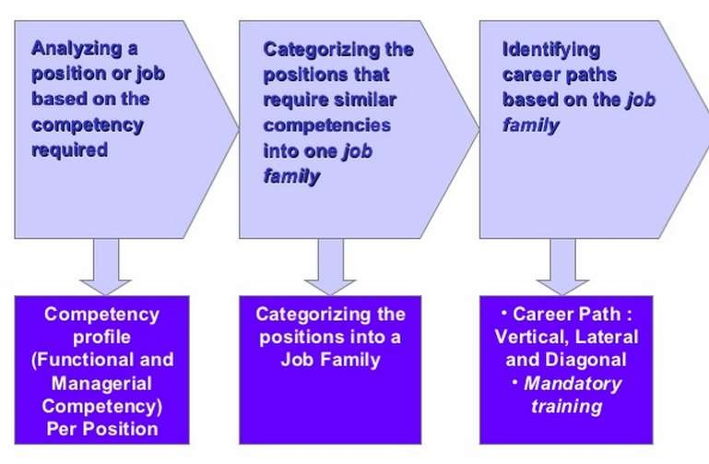
Defining Career Path
51

Slide 49
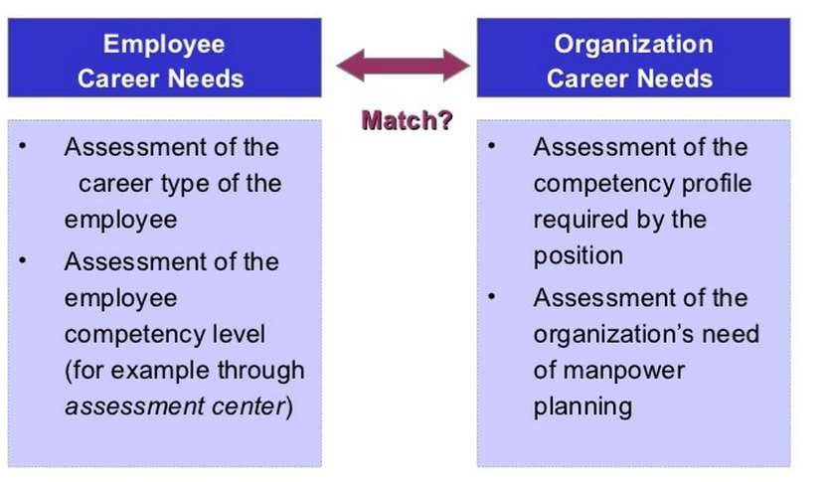
Assessing Employee Career Plan
52

Slide 50
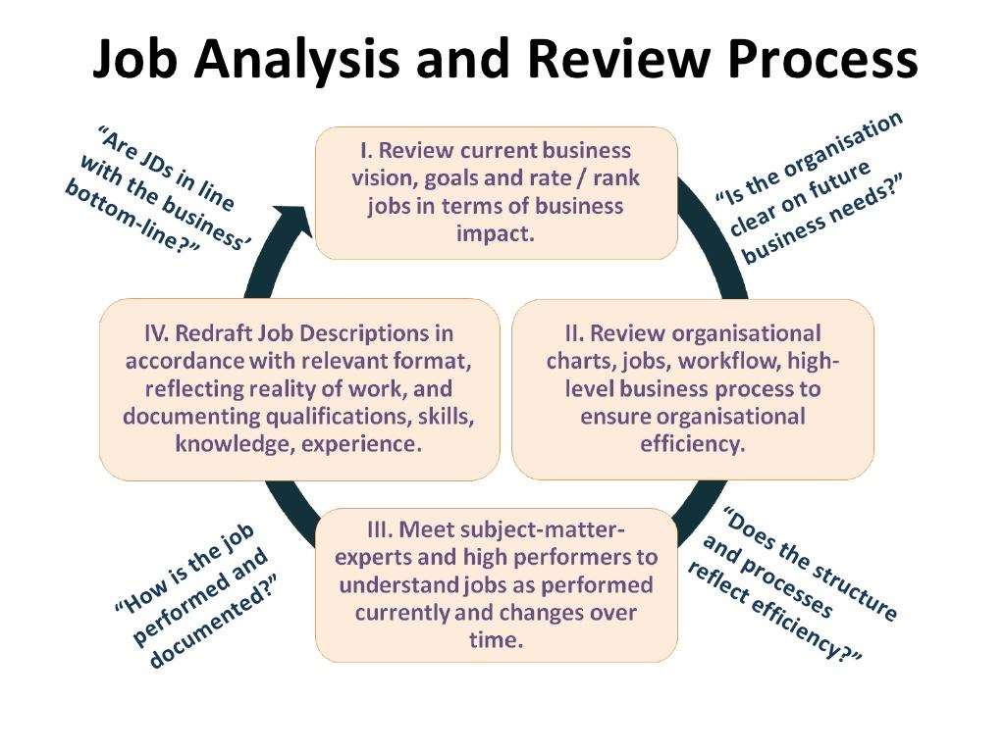

Slide 51
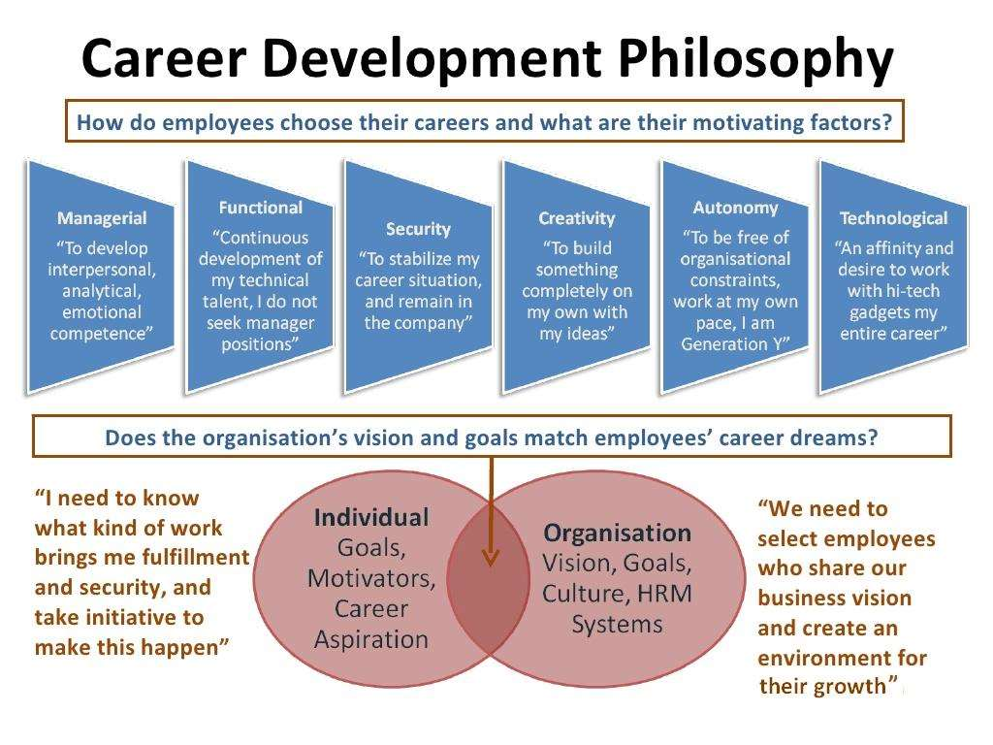

Slide 52
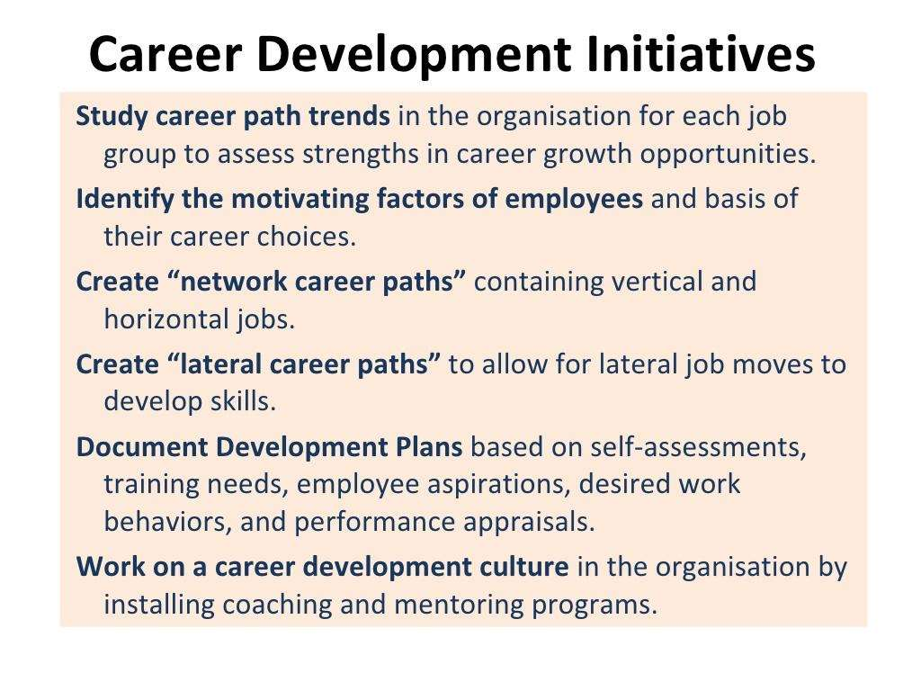

Slide 53
